Slide 1

“Cheap stakes for Cheapskates”

Slide 2

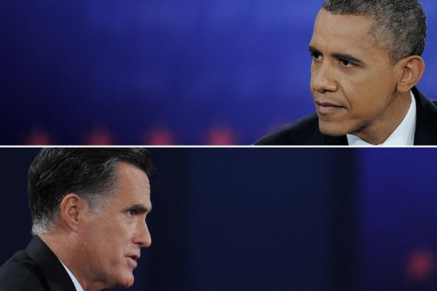

What is CheapStakes?
Betting Website
- No Money!
Bet on Any Event
Notes:
Cheap Stakes is a betting website where you can bet with no money!
Bets can be placed on any events from the biggest sporting events to general elections.
Can’t see a particular event? Submit your own for approval!
Instead of money, the website uses its own currency of points.
Points can be used to back your favourite events!
The website emphasises on friendly competition, as the top users are featured on the homepage.

Slide 3
How do I play?
NEED TO DELETE?
When a user signs up, they are granted 50 points to bet on events.
An event isn’t limited to sports; It can be anything from a General Election to Formula 1.
Can’t see a particular event? Submit your own for aproval!
The minimum bet is 10 points.
The maximum bet is all of your points!
If a user has less than 50 points, it is reset to 50 each midnight.

Slide 4
How do I play?
50
This is Bob. He has just registered.
Getting registered means he starts with 50 points
Notes:
How do I play?
When a user signs up, they are granted 50 points to bet on events.
So here is bob, he’s just registered.

Slide 5
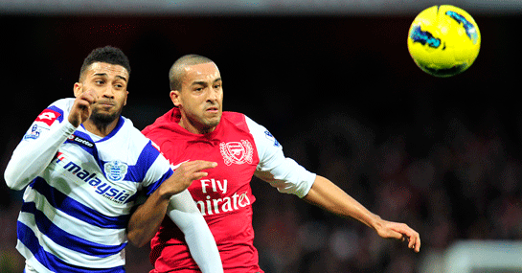
How do I play?
50
QPR vs Arsenal
10
40
QPR
Arsenal
He sees an event he likes and decides to gamble his points
Draw
He bets 10 points that arsenal will win
Notes:
He sees an event he likes and wants to gamble his points
The minimum bet he can make is 10 points, so to be safe, bob bets 10 points.
If bob wanted to live life on the edge, he could have bet all his points! There is no maximum bet

Slide 6
How do I play?
QPR vs Arsenal
40
QPR
Arsenal
10
He bets 10 points that arsenal will win
Draw

Slide 7
How do I play?
The Match is on
Betting is closed
Bob watches the game anxiously, hoping his team wins
The Results Are In!
Notes:
You can’t place bets once the event has started

Slide 8
How do I play?
Did he guess correctly, and win some points?
Or incorrectly, losing them?
Congratulations, Bob!
40
70
+30
The Results Are In!
Arsenal won, and the multiplier caused bob to win triple his points back.
Bob is now one step closer to becoming player of the week!
Notes:
There will be a multiplier that is used to calculate how many points a person will win in response to their bet.
The odds multiplier is dictated by how popular an outcome is.
Earning points will put you on our leader board.
And at midnight, if you have less than 50 points, you will reset back to 50!

Slide 9
What is a League Table?

Slide 10
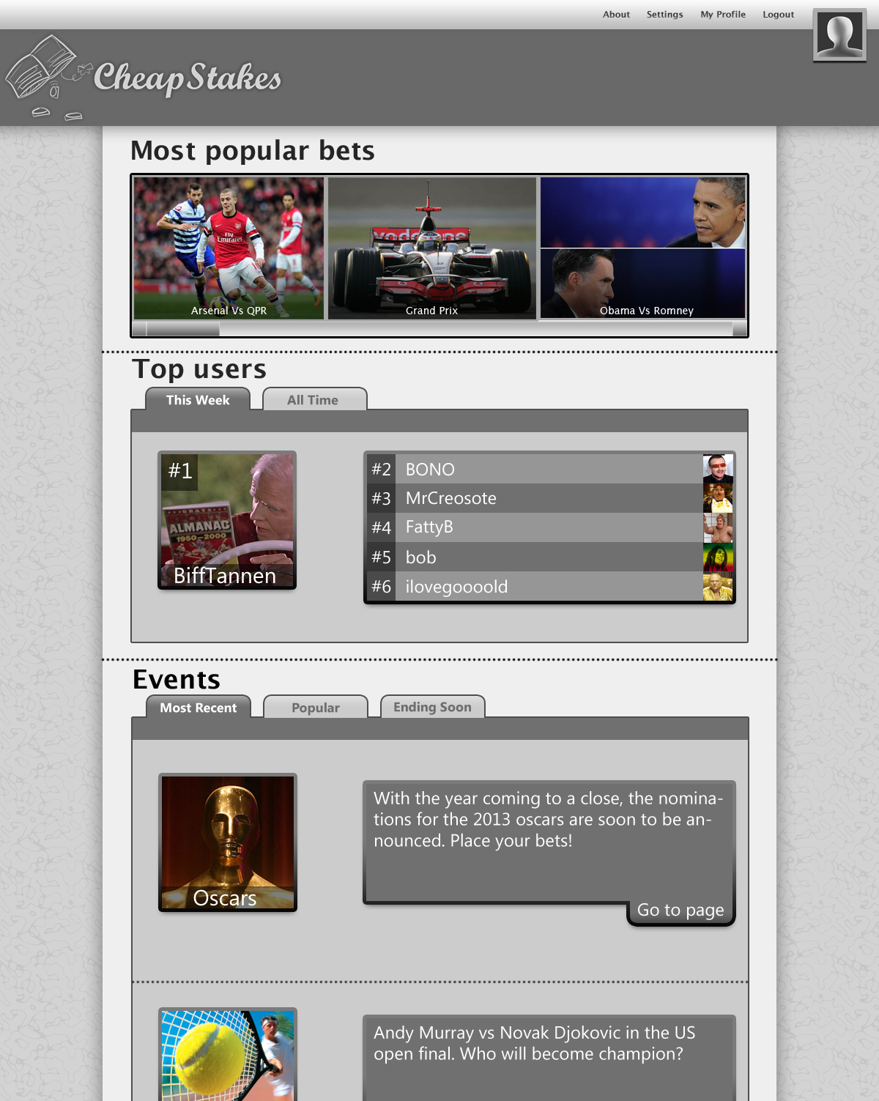
Navigation, login/logout, links to the user’s profile
The most popular events of the week.
A featured list of weekly and all time top-scoring users.
A tabulated list of events.

Slide 11
Top of the homepage
Quick access to the most popular events of the week
User account settings: Login, logout, signup
Navigation bar which remains at the top

Slide 12
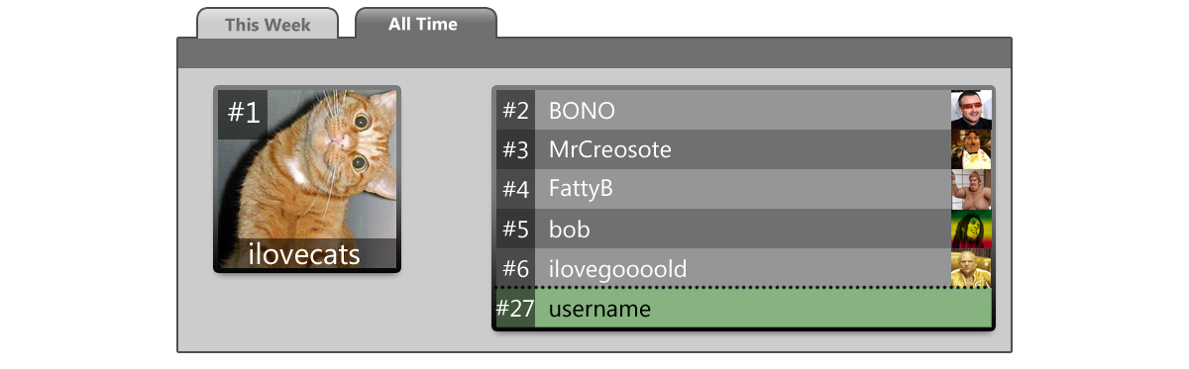
c
c
c
Leaderboards
By default, the highest scoring users of the week are loaded.
Can switch between weekly and all time top users. In all time view, the user’s position is shown.
Clicking on a user’s entry will take you to their userpage

Slide 13
The Userpage
New and popular events
Paged lists of events can be browsed by the user.
The tabs can be used to filter events by most recent, most popular, and ending soon.
Links to the event’s page

Slide 14
Navigation, login/logout, links to the user’s profile
Categories Page
The most popular events of the week.
A featured list of weekly and all time top-scoring users.
A tabulated list of events.

Slide 15
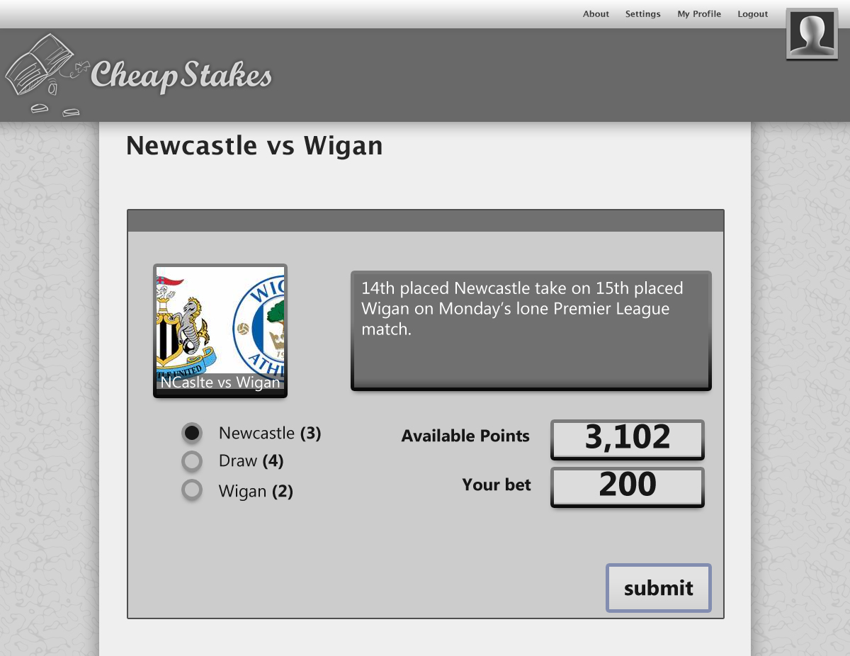
Navigation, login/logout, links to the user’s profile
The most popular events of the week.
A featured list of weekly and all time top-scoring users.
A tabulated list of events.

Slide 16
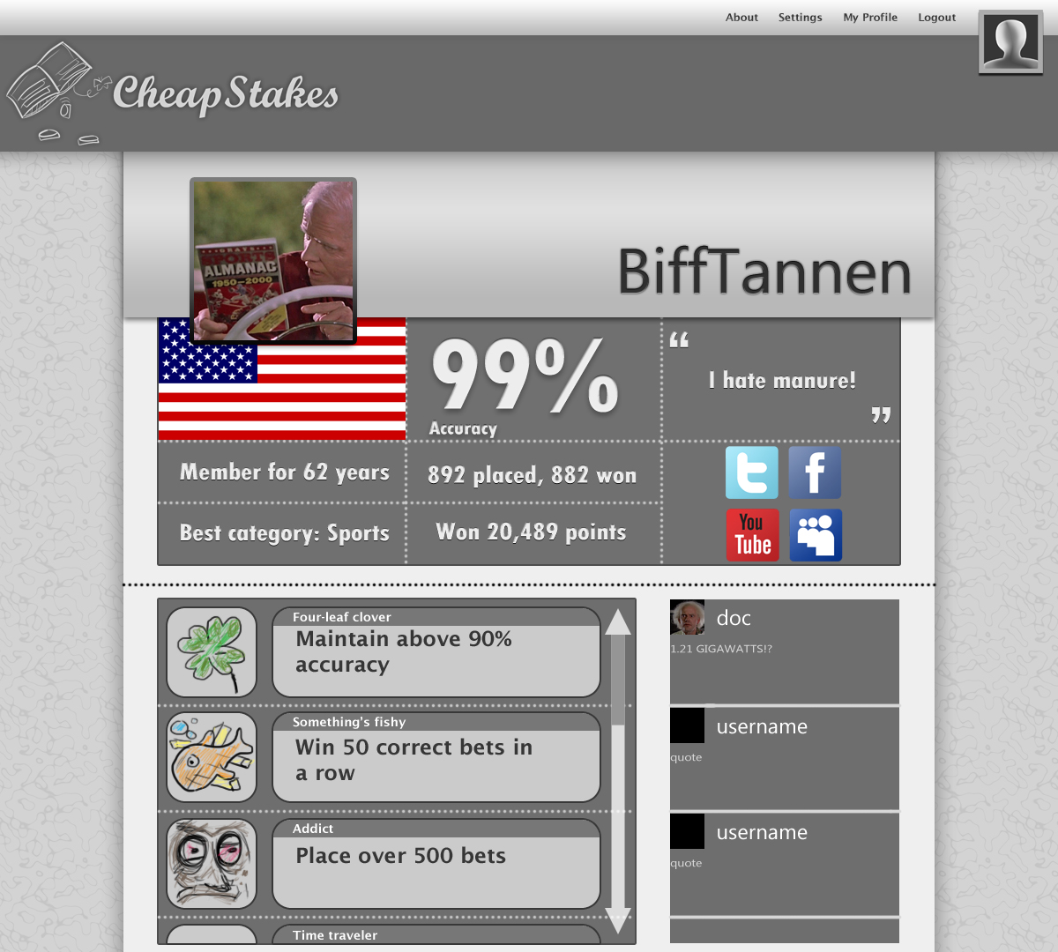
The Userpage
Statistics about the user
Comments left by other users.
The user’s achiev-ements

Slide 17
User statistics displayed in large boxes: Accuracy, best category, winning statistics, personal quote, links to social networks
A user’s accuracy is determined by: Winning bets / Total bets
A user’s best category has the highest accuracy
The user’s country is defined in their user settings

Slide 18
Users score achievements which are displayed on their profile
Other users can comment on a user’s profile

Slide 19
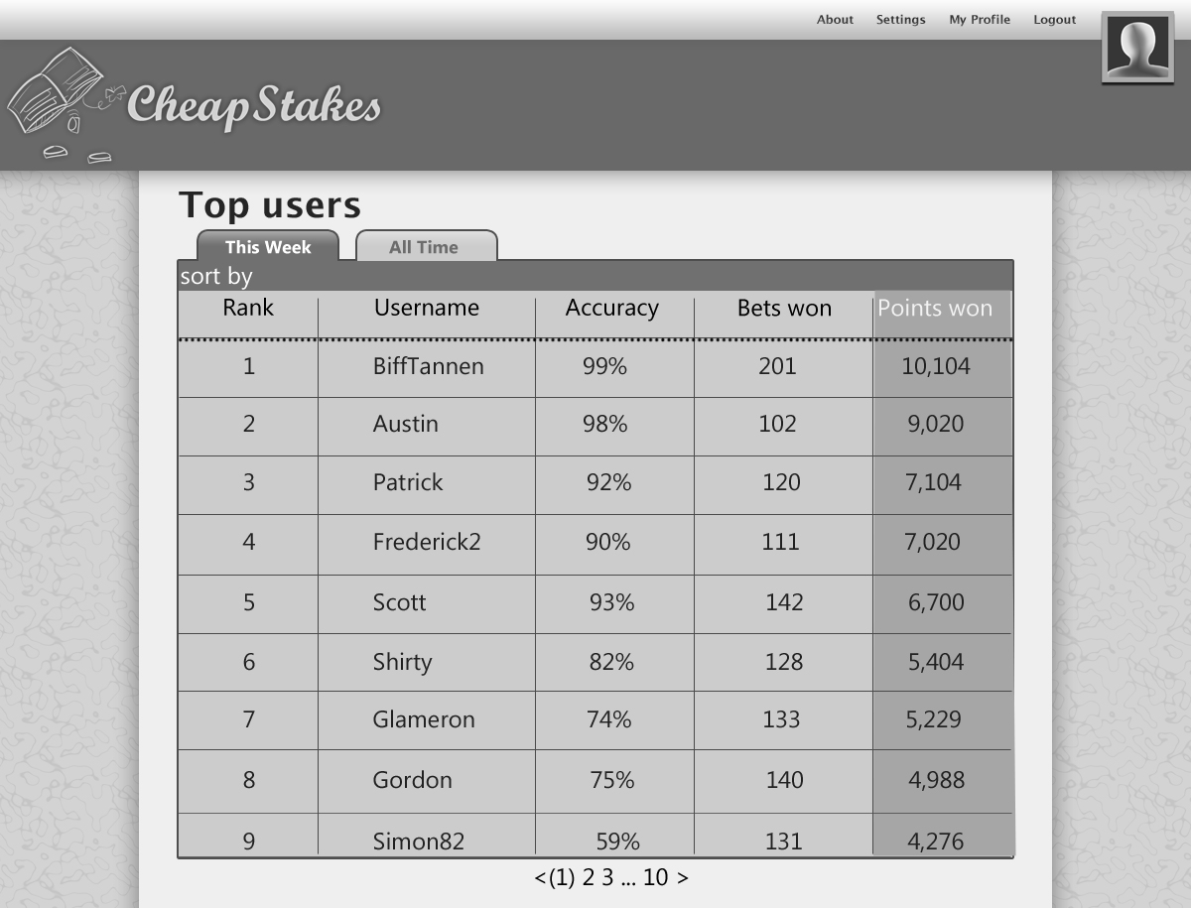
Navigation, login/logout, links to the user’s profile
The most popular events of the week.
A featured list of weekly and all time top-scoring users.
A tabulated list of events.

Slide 20
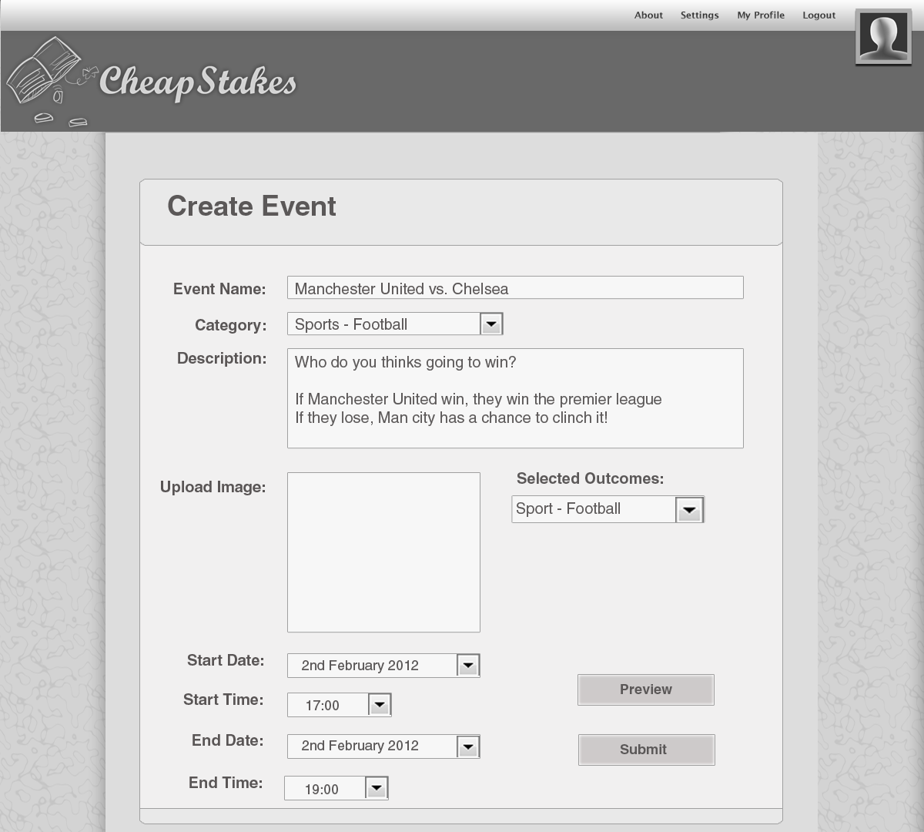
Navigation, login/logout, links to the user’s profile
The most popular events of the week.
A featured list of weekly and all time top-scoring users.
A tabulated list of events.

Slide 21
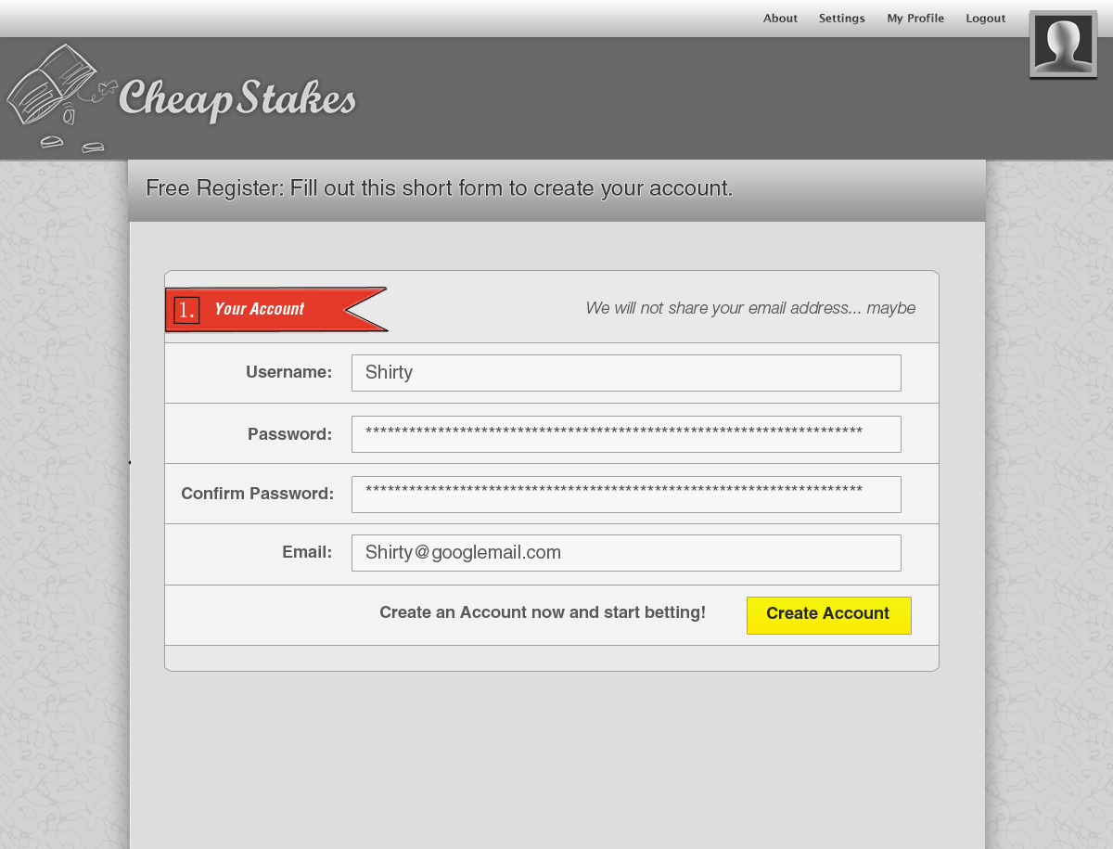
Navigation, login/logout, links to the user’s profile
The most popular events of the week.
A featured list of weekly and all time top-scoring users.
A tabulated list of events.

Slide 22
Settings and Contact Us
Setting: change birthday, email, nationality, personal details etc
Contact us: Compay Email

Slide 23
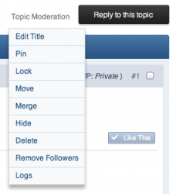
Behind the Scenes
Moderation:
User’s events are put in a Moderation Queue
Awaiting approval
Moderators can edit, move, delete, merge or hide
topics
Moderator’s can add results, add and remove points

Slide 24

Technical Understanding
Is it Realistic?
- Yes it is!
Do we have the Knowledge and Experience?
- Some, but we are learning!
Can you complete what you set out to do in time?
- Should do!
Notes:
Intro:
We chose to take on the project which involved HTML, PHP, CSS, MySQL and JavaScript.
When we thought about making the website we asked ourselves these 3 questions
Is it realistic?
- stuff
Do we have the knowledge and Experience?
Realistically, only 2 of us have had experience with HTML and PHP outside the COMP101 labs Also, of those, only 1 has had experience with MySQL and no-one has used JavaScript before.
However, our website can be built using the knowledge we gained from our COMP101 labs almost exclusively. Only, this project is a lot larger than what we have done in the comp 101 labs
Learning JavaScript is relatively easy as it is comparable to java.
Can we complete what we set out to do in time?
We believe we can complete this project in time as we are all fast learners with a good work ethic.
We are committed and we know each other’s strengths and so we can work to them.

Slide 25





Development
The tools we’re going to use:
JavaScript
HTML
CSS
JavaScript
PHP
MySQL

Slide 26
Database ERD
A glimpse of our Database Entity Relationship Diagram:
Categories
Users
Member ID
Bet Stats
CAT Key
Event
First Name
Member ID
Last Name
Bets Placed
Birthday
Bets Won
Events
Gender
Accuracy
Event Key
Country
Streak
Type
Join Date
Coins Won
Name
Bets Placed
Current Coins
League Table
Description
Member ID
Result
Member ID
Time & Day
Event Key
League Pos
Bets Won
Bet Placed
Accuracy
Streak
Coins Won
Current Coins

Slide 27
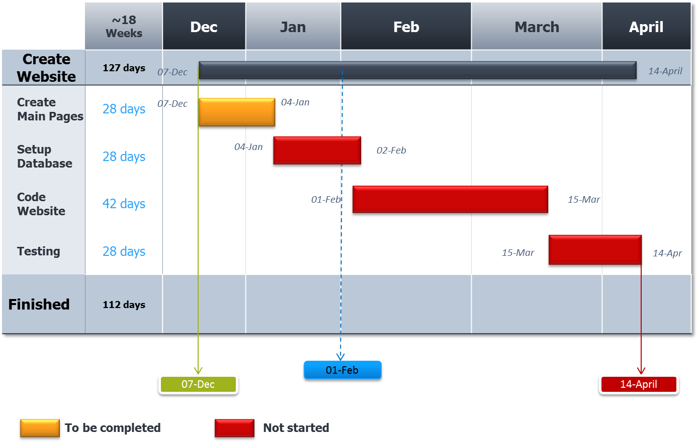
Gantt Chart

Slide 28
Limitations & Future Ambitions
We know our Limits!
Can’t bet on specific details on events
Can’t bet on more than one outcome
But we have Ambitions!
Friends System
Achievements
Special Event days aka Double winnings and website themes for festivals
Other games: Roulette, blackjack
League table display bets for months, years etc.
Profile Stats page: biggest win, biggest loss.
Forum

Slide 29
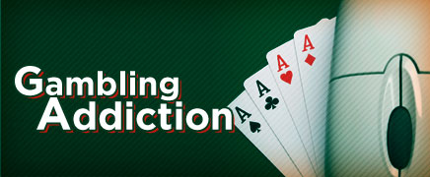
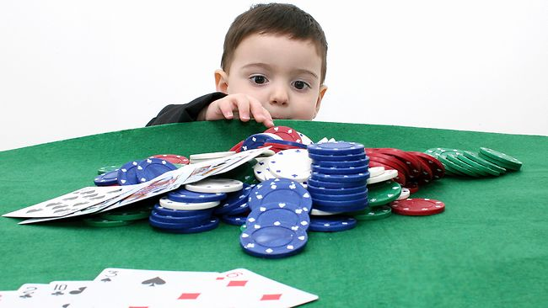
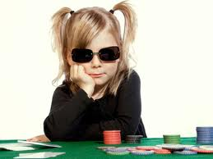
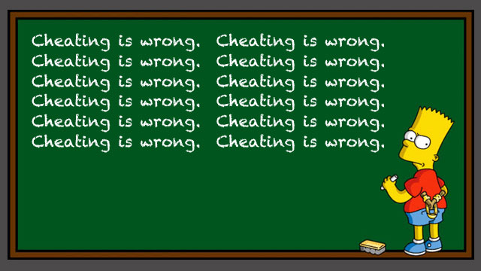
Ethical Issues
Addiction
- Too addicting
Age Restriction
- 18 and over only
Fraud
- Illegitimate games
Notes:
1. One ethical issue is that the website may become addictive and decrease peoples’ productivit
However since CheapStakes is a prediction based website that doesn’t use money as a way to bet, it may not be as addictive as an actual betting website
2. Another ethical issue that may be associated with CheapStakes, is that the idea of betting, even with points may cause some to argue that only people over the age of 18 should be allowed to play.
However, Its perfectly legal to allow anyone of any age to bet as long as there is no money involved.
3. Another ethical issue is fraud; in some betting games, people are able to cheat and get away with it
However, since this is an internet website, our code will prevent users from rigging the odds of a betting event/game.

Slide 30


Legal Issues
18 and Over Only!
- Does not Apply!
Games must be Fair
- They are!
Notes:
The ethical and legal issue that under 18 year old individuals would be allowed to place bets on the website is nullified by the definition of gambling, which is ‘playing a game of chance for money’. Since our website only uses points, it is exempt from the over 18’s only law.
We must ensure that gambling is conducted fairly and openly
We will do this as our website code will prevent people from putting the odds in their favour. Betting is always done openly as anyone can see the bets made and the event details and the odds.

Slide 31
Disclaimer
Its perfectly legal to allow anyone of any age to bet as long as there is no money involved

Slide 32
Summary

Slide 33
?
?
?
?
?
?
Any Questions?
?
?
?
?
?
?
?
?

